Slide 1
Introduction to Programming Fundamentals using C

Slide 2
Objectives
After studying this section, you should be able to:
Define some concepts related to programming
Explain how to make a good software
Understand steps to develop a software
Answer why C is the first language selected
Understand how a C program can be translated and execute
Understand a C program structure

Slide 3
Contents
Definitions
How to make a good software?
Steps to develop a software?
Overview Computer hardware
Data Units
Addressing Information
Program Instructions
Programming Languages
Compiler
Why C is the first language selected?
Some notable features of C
Structure of a simple C Program.

Slide 4
Definitions

Slide 5
Information & Data
In computer science, Information is any data that can be stored, processed, analyzed, and transmitted through digital means (such as files, databases, or the Internet).
Information in this context can include text, images, videos, or any form of data that can be encoded and processed.
Data: Values are used to describe information. So, information can be called as the mean of data

Slide 6
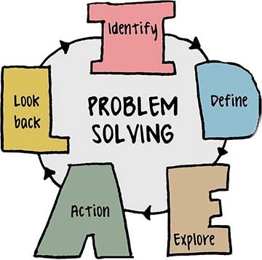
Problem, Solve a problem and Solution
Problem is a challenging situation that you face.
Solve a problem is the process of finding and applying a solution to fix or handle that problem.
Solution is an option proposed to solve a problem or achieve a goal.

Slide 7
Algorithm, Program, Computer program
An algorithm is a procedure used for solving a problem or performing a computation.
Program is a sequence of steps to find out the solution of a problem.
Computer program is a sequence or set of instructions in a programming language for a computer to execute

Slide 8
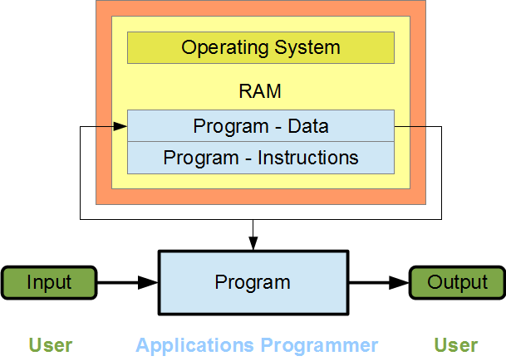
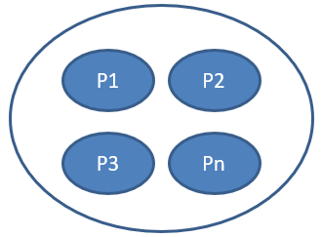
Computer program (cont.)
Computer program = data + instructions
A simulation of solution
Is a set of instructions that computer hardware will execute
Increase the performance of standard workflow
Computer software: A set of related programs

Slide 9
How to make a good software?

Slide 10
Issues for a program/ software
Usability: Users can use the program to solve the problem
Robust and user-friendly interfaces
Correctness: The solution must be correct
Comprehensive testing
Maintainability: The program can be modified easily
Understandability: Structured programming; Document the code and overall design to help others (and yourself) understand and maintain the software.
Modifiability: Standards compliance
Portability: The program can run on different platforms with minimal modification
Standards compliance → Needed modifications are minimum (platform: CPU + operating system running on it)

Slide 11
Issues for a program/ software (cont.)
Modularity:
Break the program into smaller, self-contained modules or functions.
Each module should perform a specific task or represent a logical grouping of related functionality.
Scalability:
Ensure the software can handle increased loads (e.g., more users, larger datasets) without significant performance degradation.
Opt for efficient algorithms and data structures.
Robustness:
Write software that handles errors and unexpected inputs gracefully.
Incorporate error handling, logging, and validation mechanisms.

Slide 12
Overview Computer Hardware

Slide 13
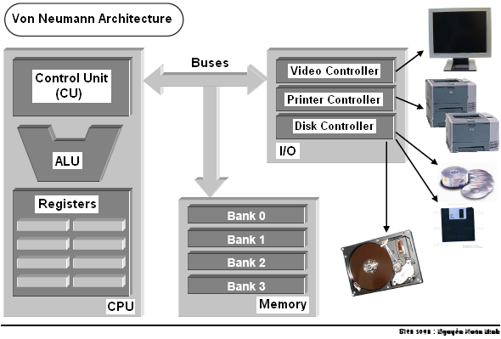
Computer Hardware - Review
3 steps to read a memory cell:
CPU puts the memory address to address bus
CPU puts the read-signal to control bus.
Data in memory cell is transferred to a register in CPU
ALU: Arithmetic and Logic Unit
Bus | Used to
Address bus | Determine the IO peripherals, position of accessed memory.
Data bus | Transmit data
Control bus | Determine operation on peripherals, read peripheral ‘s states

Slide 14
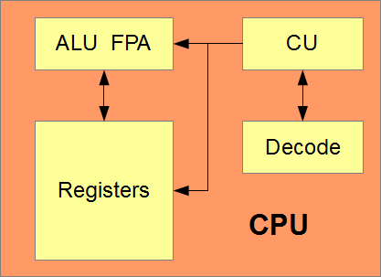
Central Processing Unit (CPU)
The CPU executes program instructions serially (one at a time). A modern CPU consists of:
Registers
A decode unit
A control unit (CU)
An arithmetic and logic unit (ALU)
A floating-point accelerator (FPA)
Notes:
- Registers are the CPU's internal memory. They hold the data used by the ALU and FPA and any new data that the ALU and FPA produce. Register data is volatile: we lose the contents of each register as soon as we turn off power.
- The Decode unit extracts each incoming instruction from the instruction queue and decodes that instruction. The CU moves data between registers, RAM and the devices, and passes the decoded instruction to the ALU or the FPA for processing. The CU manages the data, but does not change it.
- The ALU performs the comparisons and integer calculations, changes the data and creates new data as directed by the CU. The FPA performs the calculations on floating-point data. The ALU and FPA work solely with register memory inside the CPU.

Slide 15
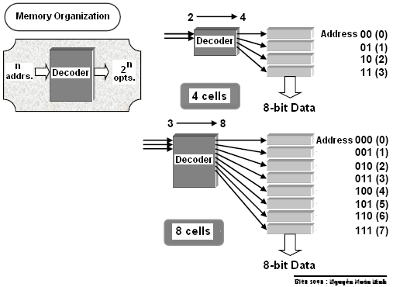
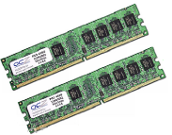
Primary Memory
Primary memory is memory directly accessible by the CPU. Primary memory includes: ROM, RAM
ROM holds the instructions for starting the system. ROM is not volatile.
RAM holds the program instructions and the program data. RAM is volatile

Slide 16
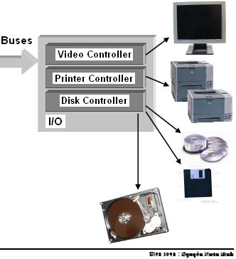
Devices
Include basic I/O devices such as a keyboard, a monitor and a mouse, …
Storage devices such as a floppy drive, a hard drive and a CD-ROM drive (secondary storage).
All device interfaces connect to the system buses through a central controller.

Slide 17
Data Units

Slide 18
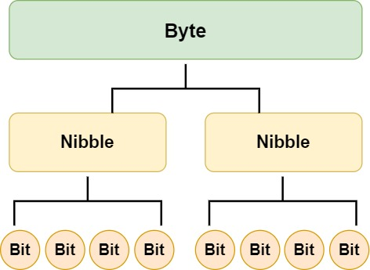
Data Units
Transistor is the basic physical unit for storing data → Binary format
John von Neumann selected binary (base 2) digits as the EDVAC's fundamental unit.
The vast majority of modern computers process and store information in binary digits.
We call a binary digit as a bit.
Nibble = 4 consecutive bits.
Byte = 8 consecutive bits = 2 nibbles
Unit of memory is BYTE
00000000 ← possibility 0 00000001 ← possibility 1 00000010 ←possibility 2 00000011 ← possibility 3 00000100 ← possibility 4 ... 00111000 ← possibility 104 ... 11111111 ← possibility 255

Slide 19
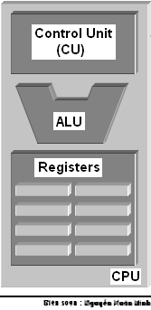
Data Units (cont.)
The natural unit of the CPU is a word.
The word length is number of bits of a general register within CPU (CPU memory).
Word length can be 8, 16 (old CPUs), 32, 64 (current CPUs)

Slide 20
Addressing Information

Slide 21
Addressing Information
Each byte of primary memory has a unique address (order number), starting from zero.
Addressible Memory: The maximum size of addressable primary memory depends upon the size of the address registers
 | MEMORY
… | …….
5 | 1010 1010
4 | 0011 1100
3 | 0101 0100
2 | 1001 0000
1 | 1100 1011
0 | 0100 0001
Name | Symbol | Size
KiloByte | KB | 1,024 Byte
MegaByte | MB | 1,024 KB
GigaByte | GB | 1,024 MB
TeraByte | TB | 1,024 GB
PetaByte | PB | 1,024 TB
ExaByte | EB | 1,024 PB
Address
Value

Slide 22
Program Instructions

Slide 23
Program Instructions
01001011 | 100110110110 | 011011010111
Opcode | Operand 1 | Operand 2
Each program instruction consists of an operation and operands
The CPU performs the operation on the values stored as operands or on the values stored in the operand addresses.
Operands: Constants, registers, primary memory addresses

Slide 24
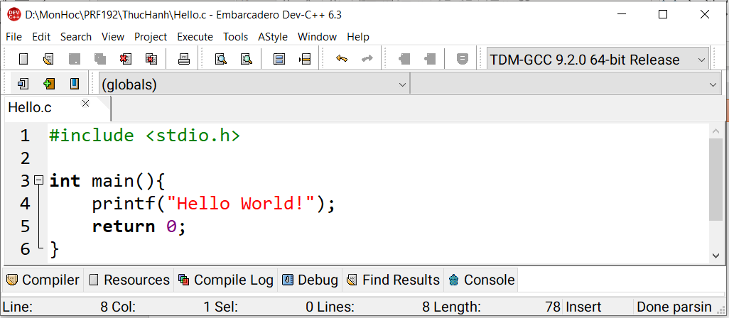
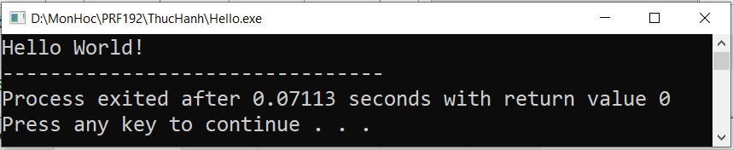
Let's create our first C file.
Open Dev-C++ → File → New → Source File to create: Hello.c
Execute → Compile & Run or F11 key press to execute the program:

Slide 25
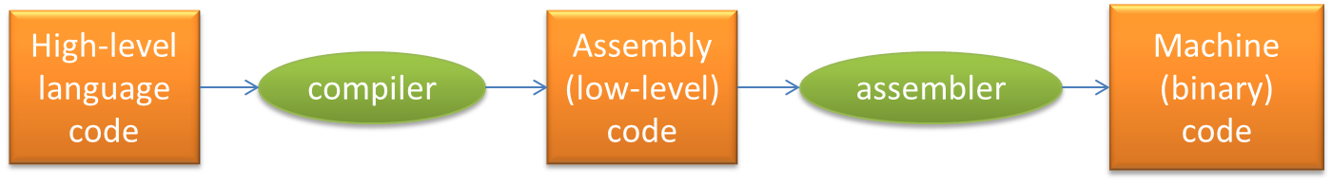

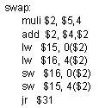
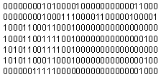
Program Instructions (cont.)

Slide 26
Programming Languages

Slide 27
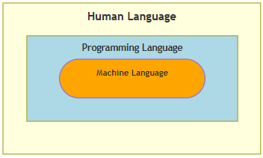
Programming Languages
Programs that perform relatively simple tasks and are written in assembly language contain a large number of statements.
Machine Language → Assembly language → High-level languages.
To make our programs shorter, we use higher-level languages.

Slide 28
5 Generations of Programming Languages
Machine languages.
Assembly languages.
Third-generation languages. These are languages with instructions that describe how a result is to be obtained (C, Pascal, C++, Java…).
Fourth-generation languages. These are languages with instructions that describe what is to be done without specifying how it is to be done (SQL).
Fifth-generation languages are the closest to human languages. They are used for artificial intelligence, fuzzy sets, and neural networks (Prolog, Matlab)

Slide 29
Compiler

Slide 30
Translating and Executing a Program
Program code in a high level language can not run. It must be translated to binary code (machine code) before running.
2 ways of translations:
Interpreting: One-by-one statement is translated then run → Interpreter
Compiling: All statements of program are translated then executed as a whole → Compiler
C translator is a compiler

Slide 31
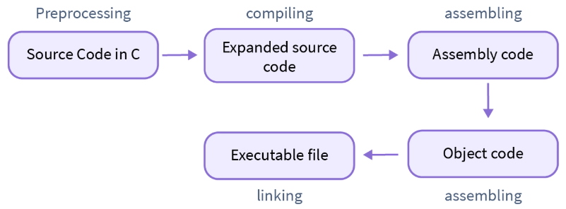
Compiler
The compilation process in C is:
Converting an understandable human code into a machine understandable code
Checking the syntax and semantics of the code to determine any syntax errors or warnings present in our C program.
Compilation process in C involves four steps:
Preprocessing
Compiling
Assembling
Linking

Slide 32
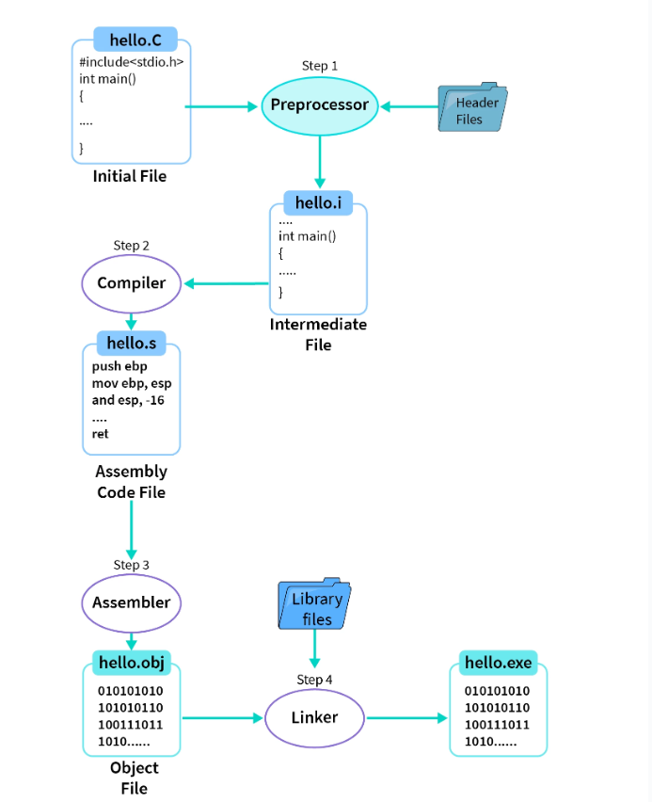
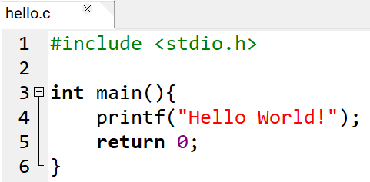
Compilation process
Compilation process

Slide 33
Compilation process (cont.)
The C program file hello.c
Step 1: Preprocessing of header files, all the statements starting with # symbol and comments are replaced/removed. Generates an intermediate file hello.i
Step 2: Compiler software translates the hello.i file to hello.s with assembly level instructions (low-level code).
Step 3: Assembly-level code instructions are converted into machine-understandable code (binary/hexadecimal form) by the assembler. The file generated is known as the object file with an extension of .obj/.o i.e. hello.obj/hello.o file.
Step 4: Linker is used to link the library files with the object file to define the unknown statements. It generates an executable file with .exe/.out extension i.e. a hello.exe/hello.out file.
Next, run the hello.exe/hello.out executable file to get the desired output on our output window, i.e., Hello World!.

Slide 34
Why C is the first language selected?

Slide 35
Why C is the first language selected?
C is one of the most popular languages in use globally
Some reasons for learning programming using the C language includes:
C is English-like,
C is quite compact - has a small number of keywords,
A large number of C programs need to be maintained,
C is the lowest of high-level languages,
C is faster and more powerful than other high-level languages,
The UNIX, Linux and Windows operating systems are written in C and C++.
The most common languages, such as Java, C#, are similar to C.
C supports basic ways which help us understanding memory of a program. These can be hidden in higher languages.
Language | Time to Run
Assembly | 0.18 seconds
C | 2.7 seconds
Basic | 10 seconds
Comparative times for a Sieve of Eratosthenes test

Slide 36
Some Notable C Features

Slide 37
Some Notable C Features
Comments
/* */
We use comments to document our programs and to enhance their readability. C compilers ignore all comments.
Whitespace
We use whitespace to improve program readability and to display the structure of our program's logic. C compilers ignore all whitespace
Case Sensitivity
C language is case sensitive.
C compilers treat the character 'A' as different from the character 'a' .

Slide 38
Structure of a Simple C Program

Slide 39
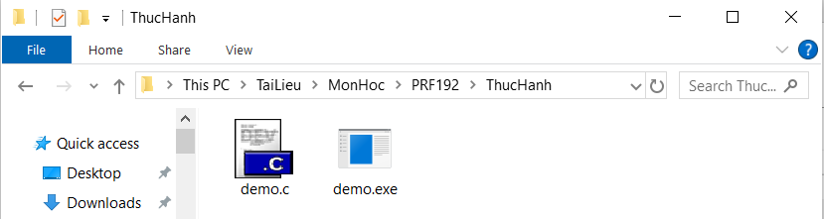
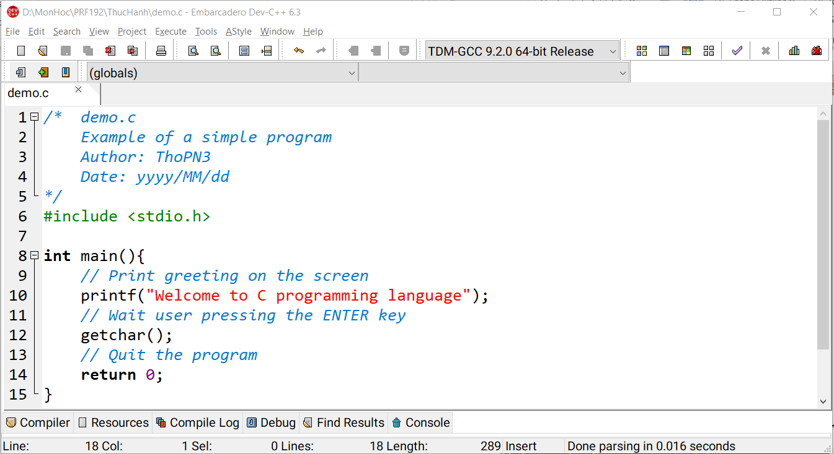

Compile and run with Dev-CPP
Comment for program description
Declaration for library using
Entry point of C program
Statements + Comments
Exit point of C program

Slide 40
Compile and run a program using the command prompt
Step 1: Install a C Compiler
Download and install MinGW or TDM-GCC.
(Link download MinGW: https://sourceforge.net/projects/mingw/)
During installation, ensure the gcc tool is included.
Step 2: Set Up Environment Variables
Add the bin directory of MinGW (e.g., C:\MinGW\bin) to your PATH environment variable:
Go to Control Panel → System and Security → System → Advanced System Settings → Environment Variables.
Find the Path variable in System Variables, click Edit, and add the bin directory path (C:\MinGW\bin)

Slide 41
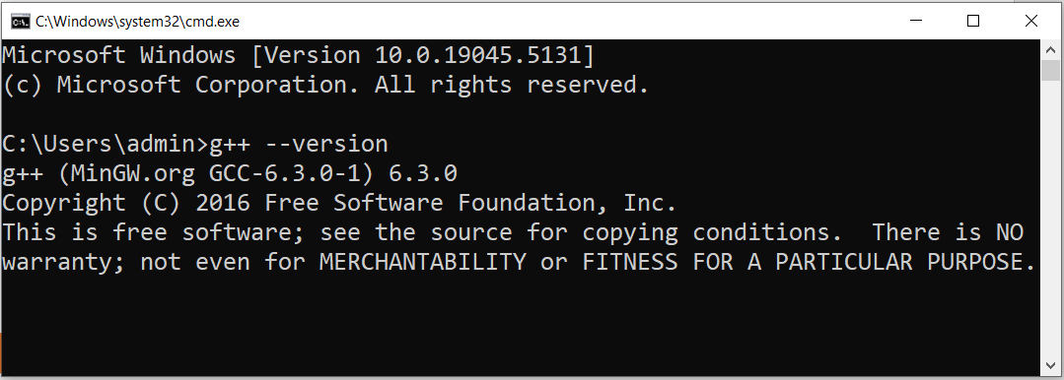
Compile and run a program using the command prompt (cont.)
Step 3: Test Environment:
Open Command Prompt and type: g++ --version

Slide 42
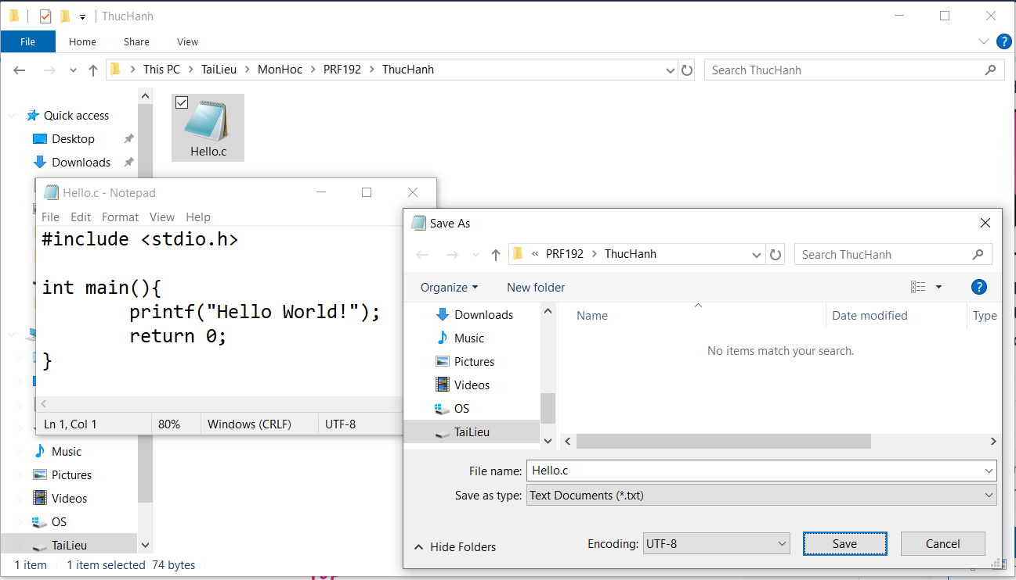
Compile and run a program using the command prompt (cont.)
Step 4: Write a program Hello.c
3
1
2

Slide 43
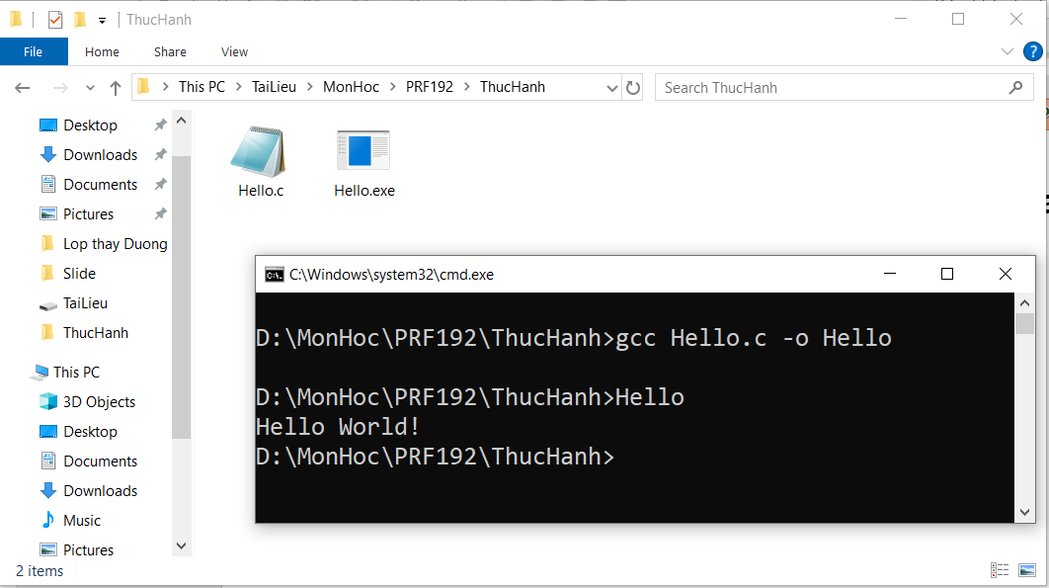
Compile and run a program using the command prompt (cont.)
Step 5: Compile & Run
(1) Compile
(2) Run
(3) Output

Slide 44
Structure…: C program Entry Points
Entry point: The point where a program begins.
Entry points of C-programs:
[int] main( [void] )
{
<statements>
[ return number; ]
}
Syntax:

Slide 45
Summary
Definitions related to programming
How to make a good software?
Steps to develop a software?
Computer hardware.
Fundamental Data Units
Program Instructions
Programming Languages
C Compilers
Why C is the first language selected?
Some notable features of C
Structure of a simple C Program.

